Slide 1
UNSUPERVISED LEARNING

Slide 2
The Difference between Supervised and Unsupervised Learning
Supervised and Unsupervised learning are the two techniques of machine learning.
However both techniques are used in different scenarios and with different datasets.

Slide 3
The Difference between Supervised and Unsupervised Learning
Supervised Learning
a machine learning method in which models are trained using labelled data
models need to find the mapping function to map the input variable (X) with the output variable (Y) → Y=f(X)
needs supervision to train the model, which is similar to as a student learns things in the presence of a teacher
can be used for two types of problems: Classification and Regression

Slide 4
The Difference between Supervised and Unsupervised Learning
Unsupervised Learning
another machine learning method in which patterns inferred from the unlabelled input data
The goal of unsupervised learning is to find the structure and patterns from the input data
Unsupervised learning does not need any supervision. Instead, it finds patterns from the data by its own

Slide 5
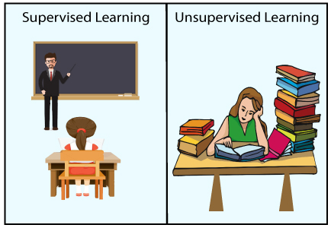
The Difference between Supervised and Unsupervised Learning

Slide 6
The Difference between Supervised and Unsupervised Learning
Supervised Learning | Unsupervised Learning
Supervised learning algorithms are trained using labelled data. | Unsupervised learning algorithms are trained using unlabelled data.
Supervised learning model takes direct feedback to check if it is predicting correct output or not. | Unsupervised learning model does not take any feedback.
Supervised learning model predicts the output. | Unsupervised learning model finds the hidden patterns in data.
In supervised learning, input data is provided to the model along with the output. | In unsupervised learning, only input data is provided to the model.
The goal of supervised learning is to train the model so that it can predict the output when it is given new data. | The goal of unsupervised learning is to find the hidden patterns and useful insights from the unknown dataset.
Supervised learning needs supervision to train the model. | Unsupervised learning does not need any supervision to train the model.

Slide 7
The Difference between Supervised and Unsupervised Learning
Supervised Learning | Unsupervised Learning
Supervised learning can be categorized in Classification and Regression problems. | Unsupervised Learning can be classified in Clustering and Associations problems.
Supervised learning can be used for those cases where we know the input as well as corresponding outputs. | Unsupervised learning can be used for those cases where we have only input data and no corresponding output data.
Supervised learning model produces an accurate result. | Unsupervised learning model may give less accurate result as compared to supervised learning.
We first train the model for each data, and then only it can predict the correct output. | it learns similarly as a child learns daily routine things by his/her experiences.
It includes various algorithms such as Linear Regression, Logistic Regression, Support Vector Machine, Neural Networks, Decision tree, Naïve Bayes, KNN, etc. | It includes various algorithms such as K-Means, C-Means, etc. → CLUSTERING ALGORITHMS

Slide 8
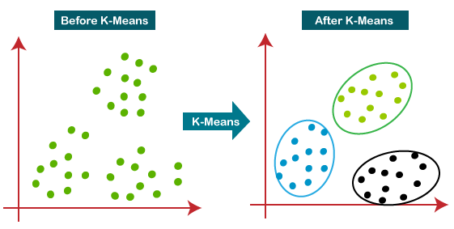
K-MEANS CLUSTERING

Slide 9
K-MEANS CLUSTERING How does the K-Means Algorithm Work?
1) Select the number K to decide the number of clusters
2) Select random K points or centroids. (It can be other samples/points from the input dataset)
3) Assign each data point to their closest centroid, which will form the predefined K clusters
4) Calculate a new centroid of each cluster
5) Repeat the third steps, which means reassign each datapoint to the new closest centroid of each cluster
6) If any reassignment occurs, then go to step-4 else FINISH

Slide 10
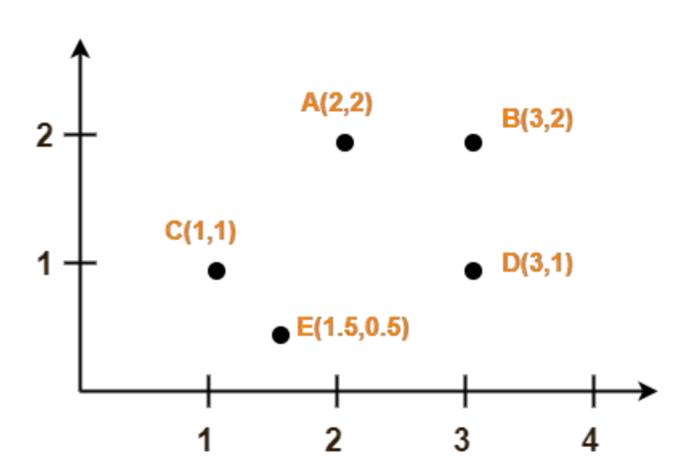
K-MEANS CLUSTERING - EXAMPLE
Use k-means to create 2 CLUSTERS

Slide 11
K-MEANS CLUSTERING - EXAMPLE
Center of 1st cluster C1
Use k-means to create 2 CLUSTERS
Assume A(2, 2) and C(1, 1)
centers of the two clusters
Use Euclidean distance
Center tof 2nd cluster C2

Slide 12
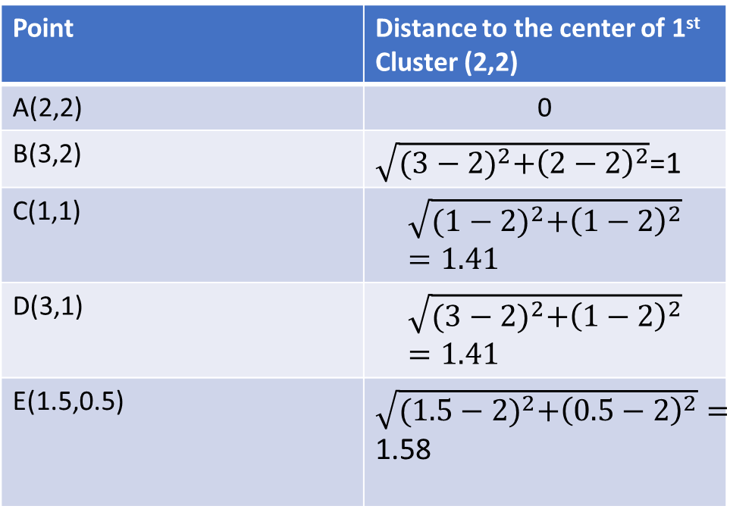
K-MEANS CLUSTERING - EXAMPLE
calculate the distance between each point and the centers of the two clusters
Point | Distance to the center of 1st Cluster (2,2)
A(2,2) | 0
B(3,2) | $\sqrt{{(3−2)}^{2}+{\left(2−2\right)}^{2}}$=1
C(1,1) | $$\sqrt{{(1−2)}^{2}+{\left(1−2\right)}^{2}}=1.41$$
D(3,1) | $$\sqrt{{(3−2)}^{2}+{\left(1−2\right)}^{2}}=1.41$$
E(1.5,0.5) | $\sqrt{{(1.5−2)}^{2}+{\left(0.5−2\right)}^{2}}=$ 1.58

Slide 13
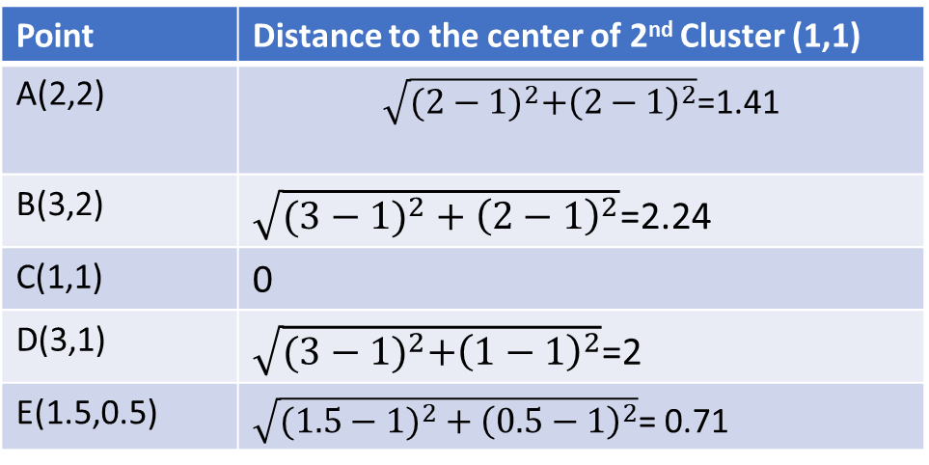
K-MEANS CLUSTERING - EXAMPLE
calculate the distance between each point and the centers of the two clusters
Point | Distance to the center of 2nd Cluster (1,1)
A(2,2) | $\sqrt{{(2−1)}^{2}+{\left(2−1\right)}^{2}}$=1.41
B(3,2) | $\sqrt{({3−1)}^{2}+{\left(2−1\right)}^{2}}$=2.24
C(1,1) | 0
D(3,1) | $\sqrt{{(3−1)}^{2}+{\left(1−1\right)}^{2}}$=2
E(1.5,0.5) | $\sqrt{({1.5−1)}^{2}+{\left(0.5−1\right)}^{2}}$= 0.71

Slide 14
K-MEANS CLUSTERING - EXAMPLE
Determine the closest centroid!
A belongs to the 1st cluster C1 → point A is closer to the centroid of the first cluster than the centroid of the second cluster (0 vs. 1.41).
B belongs to the 1st cluster C1
C belongs to the 2nd cluster C2
D belongs to the 1st cluster C1
E belongs to the 2nd cluster C2

Slide 15
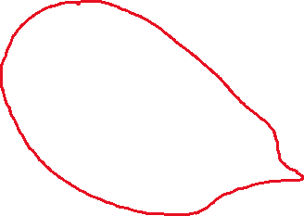
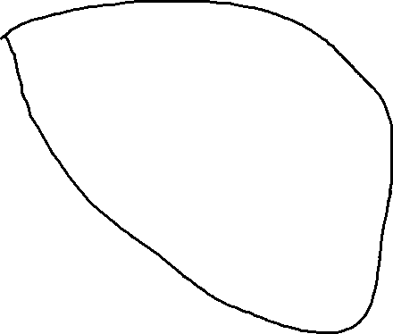
After first iteration
CLUSTER 1 C1
CLUSTER 2 C2

Slide 16
K-MEANS CLUSTERING - EXAMPLE
Calculate the new centroids of each cluster!
c(C1)=? and c(C2)=?
How?
By taking mean (averaging) of all the points contained in that cluster.
New centroids (centers of each cluster):
For C1: Points A, B, D → ((2+3+3)/3, (2+2+1)/3)=(2.67, 1.67)
For C2: Points C, E→ ((1+1.5)/2, (1+0.5)/2)=(1.25, 0.75)

Slide 17
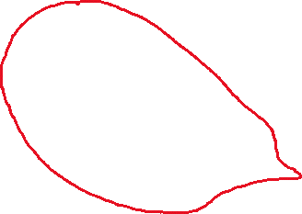

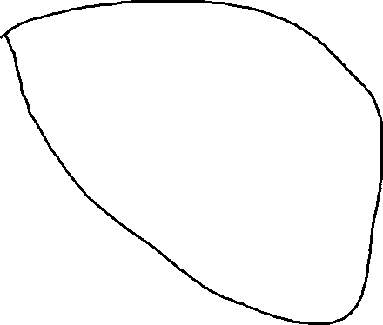
After first iteration New CENTROIDS
CLUSTER 1 C1
CLUSTER 2 C2
New centroid
(2.67,1.67)
New centroid
(1.25,0.75)

Slide 18
K-MEANS CLUSTERING - EXAMPLE
WHEN TO FINISH?
until the centers do not change anymore!

